Slide 1
Predicting Loan Approvals
Data Mining, Dr. Gizem Aydin, Winter 2024
Group 6: Ariel Azria, Alex Yeager, Ashley Nicolas, Arpan Pradhan, Ce Zhang
Notes:
Ariel

Slide 2

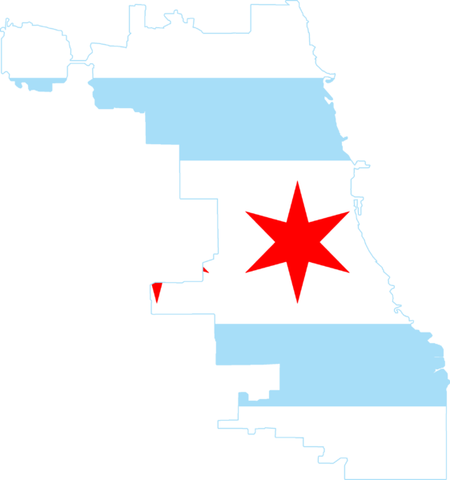
Business Problem: Automated Loan Approval System
Key Stakeholders
Credit Phoenix is a small start-up that offers loans to underserved communities in Chicagoland.
As the new data science team for Credit Phoenix, we have been tasked with reviewing key data sources and internal processes.
Strategic Considerations
As a new market entrant, Credit Phoenix is seeking to eliminate manual processes to scale to meet demand, and compete against larger competitors.
Our focus on underserved communities creates additional challenges - but also opportunity to build proprietary processes based on data.
Target Outcomes
1) | Utilize machine learning to streamline the lending approval process.
2) | Ensure model performs accurately and avoids bias towards protected classes.
3) | Understand factors in decision to extend credit to applicants
Notes:
Ce
We are a DS team for Credit Phoenix, a small start-up that offers loans to underserved communities in Chicago, and we are trying to build a Automated loan approval system
our task is to review key data sources and internal process, and we are trying to eliminate manual processes to be more competitive against larger firms
So our target is to streamline the lending approval process using Machine learning techniques, avoid bias towards certain protected classes, and understand the deciding factors in the loan approval process

Slide 3





Team
Ariel Azria,
Financial Business Analyst
Arpan Pradhan,
Data Scientist
Alex Yeager,
Lending Product Manager
Ce Zhang,
MLOps Specialist
Ashley Nicolas,
Chief Data Scientist
Notes:
Ariel

Slide 4
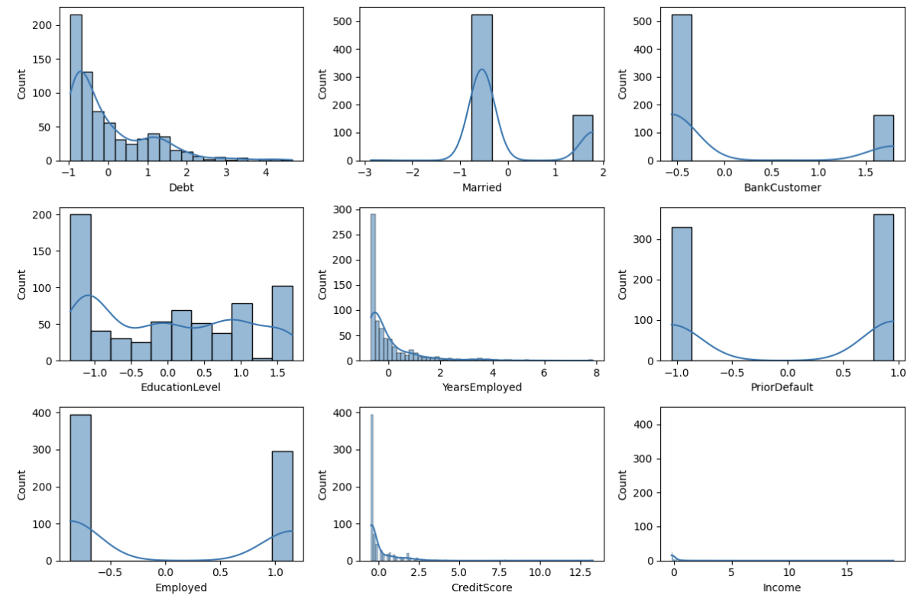
Credit Loan Approval Final Data: Visualization
Notes:
Ashley

Slide 5
How we cleaned the data (1/2)
Preliminary Steps:
Renamed columns
Removed NAs using median/mode imputation
Scaled using StandardScaler from sklearn
Legal Considerations:
Credit Phoenix cannot make decisions on the basis of protected characteristics, so we removed the following columns:
Age
Gender
Citizen
Ethnicity
Driver’s License
Zip Code
Notes:
Arpan

Slide 6
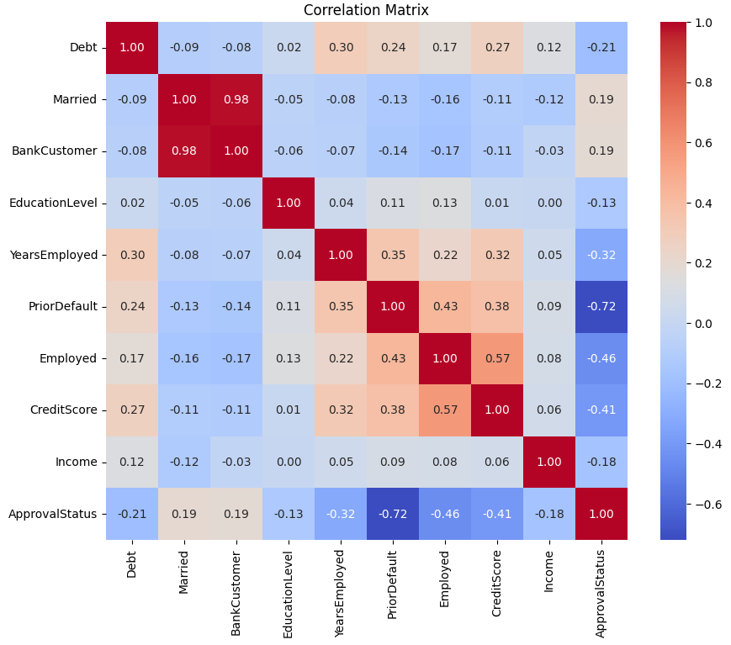
How we cleaned the data (2/2)
Correlation Plots:
Plotted all variables against each other
No high correlations (>0.70), except 0.98 between “Married” and “Bank Customer”
Removed “Married”
Test/Train Split:
690 rows, 9 columns (including response)
80/20 test/train split
Stratified the samples
Notes:
Arpan

Slide 7
Model Results: Random Forest and XGBoost are Promising
 | Business Requirements |  | Technical Considerations |  |  | Verdict
Model | Interpretability | Easy to Prove Fairness? | Model Engineering | Train Accuracy | Test Accuracy
Logistic Regression | ✓ | ✓ | GridSearchCV | 86.8 | 87.7 | Possible underfit
Decision Tree | ✓ | – | Pruning, GridSearchCV | 88.9 | 84.8 | Overfitting likely
Neural Network | ✗ | ✗ | ReLu, 10 neurons | 89.9 | 87.7 | Unsuitable for business needs
Random Forest | ✓ | – | GridSearchCV, bootstrapping, max depth = 5 | 89.9 | 88.9 | Further consideration required
XGBoost* | – | ✗ | Randomized Search, L1 penalty | 85.3 | 86.23 | Underfit? Further study needed
Random Forest and XGBoost were early candidates for further study
*Although initial performance and business use case were not as strong as other models, team was intrigued by efficiency and scalability
Notes:
Ariel

Slide 8
Model Selection (1/2): Random Forest – better performance
XGBoost
Random Forest
Test Set Metrics for XGBoost
Test Set Metrics for Random Forest
 | Predicted: 0 | Predicted: 1
Actual: 0 | TN: 58 | FP: 3
Actual: 1 | FN: 16 | TP: 61
 | Predicted: 0 | Predicted: 1
Actual: 0 | TN: 81 | FP: 11
Actual: 1 | FN: 12 | TP: 103
Accuracy | 88.89%
Precision | 90.35%
Recall | 89.57%
Random Forest performs better on accuracy and recall
Accuracy | 86.23%
Precision | 95.31%
Recall | 79.22%
Notes:
Alex
final decision came down to a choice between the XGBoost and Random Forest
goal was do be more thoughtful than just choosing based on accuracy
given our small sample size, both models would be expected to likely gain accuracy over time
however, the more balanced results of the random forest were attractive
“Recall focuses on the ability to capture all positive instances.”
our use case is loan approval, and the default state (0) is loan approval, which means true positives (1) correlate to loan denial
which means, if our model has poor recall, we are theoretically exposing ourselves to additional credit risk
as a result, our preference was to go with the more balanced model with higher recall

Slide 9
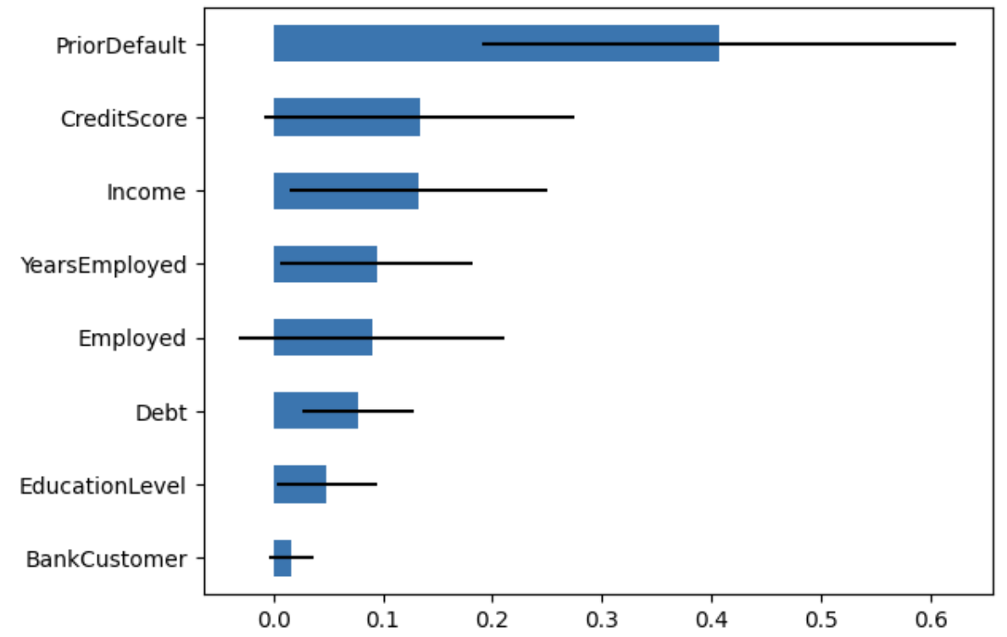
Model Selection (2/2): Random Forest – Solid Interpretability & Bias Avoidance
Random Forest Feature Importance
Interpretability
Can use local interpretable model-agnostic explanations to explain each prediction
Bias Avoidance
The model does not take any protected features into account
Checking for incidental bias: ran hypothesis tests
Compared statistical likelihood of predicted outcomes occurring, given minority populations
No bias detected for gender, ethnicity, and citizenship
Business requirements are met
Notes:
Alex
while not as intuitive as something simpler like a logistic regression, random forests do allow us to look at the key factors by relative feature importance
the items here are all highly logical factors in a credit decision - with prior default, credit score, and income leading the way
while factors such as gender, ethnicity, and citizenship were excluded - we also wanted to ensure the model was not accidentally biased against these classes
we performed hypothesis tests to confirm - which the model was able to pass (no statistically significant relationships) with these features

Slide 10
Suggested Next Steps
Implementation
New Products
Continue to monitor the Random Forest model as it matures to ensure bias stays out of model.
While the model scales and stabilizes as sample size increases - implement a “grey-box” approach aimed at additional review where the model has lower confidence.
This approach allows for additional attention to “borderline” cases, while reducing manual touches around clear cases.
Credit Phoenix has an inherently higher % of customers that are not credit worthy.
Without taking on additional risk, we cannot currently serve these customers.
Opportunity exists to increase Credit Phoenix’s addressable market via products aimed at this subset of customers…
Confidence >= threshold
Automated Yes / No
Prediction Probability
Committee Review
Confidence < threshold
Notes:
Ce
continue to monitor Random Forest model as it matures to reduce bias
as the sample size increase, implement a grey-box approach for additional attention to borderline cases with lower confidence
we are also launching new product as we have a great potential to expand our market to customers that are not credit worthy
the new product is a credit building credit card aiming our denied customers

Slide 11
New Product Suggestion: Credit-building Debit Card
Denied Applicants Consistently Have Lower Credit Scores
Competitors, such as Credit Sesame and Extra, offer a credit-building debit card that allows customers to build their credit
Companies do not assume any risk with this product, as all funds are debited from customers’ bank accounts
 | Denied Applicants | Approved Applicants
Median Credit Score* | 30 | 100
Strategically Offer Credit-Building Debit Card to Customers
Created hypothetical product which increased credit scores for our denied applicants by 100 points
With Random Forest model, 20% of previously denied applicants were approved
Using a two-proportions Z-test, we found the credit score increase to be statistically significant
Business Opportunity
Focusing on underserved communities creates opportunity to increase economic prosperity by leveraging data-driven insights
*Values multiplied by 10 to reflect the traditional US credit score system
Notes:
Ashley

Slide 12
Summary of Findings
Final Model Selection: Random Forest
Random Forest
Key Drivers: model performance, interpretability, lack of bias, scalability
Business Process Changes
Recommended to implement the model to strike balance between manual and automated process
Process will be refined as more data become available
New Product Potential
Potential to create credit-building debit card
Would help expand market for services
Notes:
In conclusion, we decided to go with the Random Forest based on a few key factors
We recommended some key business changes to marry operational value to the model
The work we did to understand Credit Phoenix’s customer base has opened the door for some promising new products, including a credit-building debit card

Slide 13
Appendix

Slide 14
Hyperparameter Tuning and Cross-Validation
Model | Tuning Method | Final Hyperparameters
Logistic Regression | GridSearchCV, 5 folds | C: 1 Penalty: L2 Solver: Liblinear
Decision Tree |  | Entropy Max depth = 5
Neural Network |  | Number of layers: 5 32 units in each layer
Random Forest |  | Bootstrap: true Max depth: 5 Min samples leaf: 1 Min samples split: 4 n estimators:
XGBoost | RandomizedSearchCV | Alpha: ~47.36 Gamma: 0 Learning rate: ~0.1558 Max depth: 8 | Min child weight: 1 number estimators: 84 Scale pos weight: 1

